Slide 1
Speed

Slide 2

By the end of the lesson, you should be able to:
Define speed
State the formula for calculating speed
Calculate speed using distance and time.

Slide 3
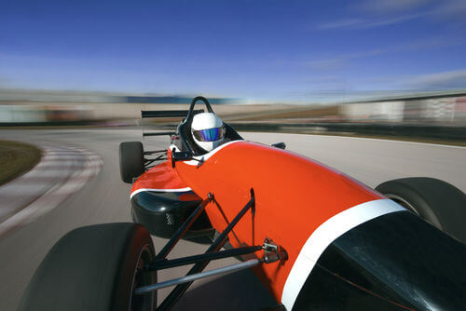
When objects move, they travel a certain distance in a certain time.
We can use these two quantities to find the speed of the object. Speed tells us how fast something moves!

Slide 4

Delta: The symbol for change
In physics, we call the change in distance Δs and the change in time Δt.
The Δ symbol is the Greek letter Delta, and means "change in." For example, a stopwatch measures changes in time.

Slide 5
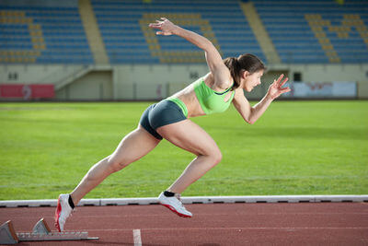
Speed describes how fast something is moving.
It is defined as the change in distance over change in time.
We measure speed in metres per second (m/s), which can also be written as ms⁻¹.

Slide 6
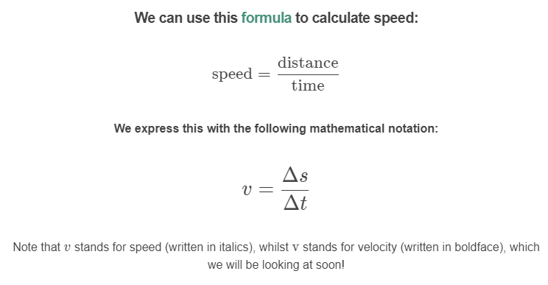

Slide 7
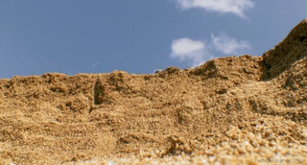
We can also rearrange this formula to find the distance that an object travels in a certain time.
distance=speed×time
Δs=v×Δt

Slide 8
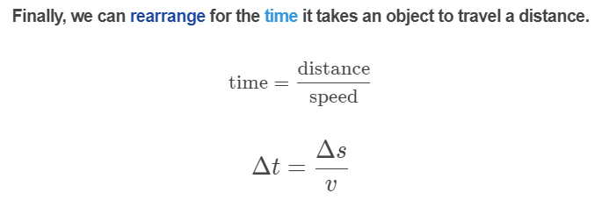


Slide 9
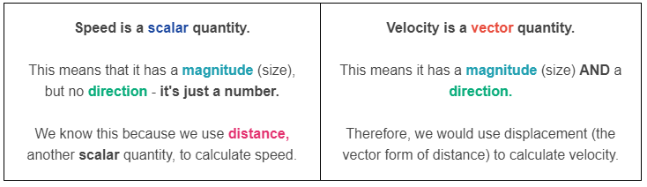
Speed vs. Velocity
The terms speed and velocity of are often used interchangeably. However, there is a subtle but very important difference!

Slide 10
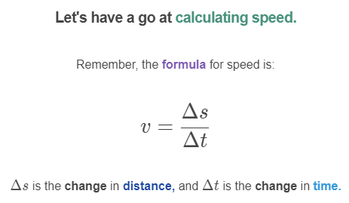

Slide 11
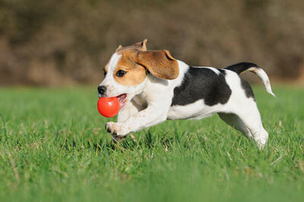
Let's work through an example together to calculate the speed of an object.
Lucy is taking her puppy to a dog park. When she throws the ball, the puppy runs 20 m to catch it. Lucy was timing the puppy, and she found that it only took 5 s to run that far.
What is the speed of the puppy?

Slide 12
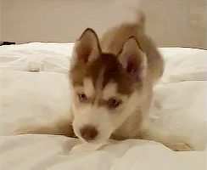
Our first step is to find the change in distance and the change in time.
The puppy ran a distance of 20 m, so Δs=20 m. This was done over a time period of 5 s, so Δt=5 s.

Slide 13
